Slide 1
Probabilistic Models for Supervised Learning(1): Probabilistic Linear Regression
CS771: Introduction to Machine Learning
Piyush Rai

Slide 2
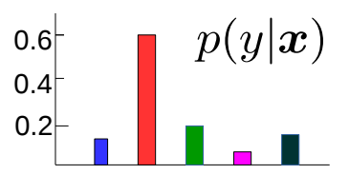




Probabilistic Models for Supervised Learning
Goal: Learn the conditional distribution of output given input, i.e., $p(y|x)$
$p(y|x)$ is more informative than a single prediction $y$
From $p(y|x)$, can get “expected” or “most likely” output $y$
For classifn, “soft” predictions (e.g., rather than yes/no, prob. of “yes”)
“Uncertainty” in the predicted output $y$ (e.g., by looking at the variance of $p(y|x)$)
Can also learn a distribution over the model params using fully Bayesian inference
Probabilistic Linear Regression
Probabilistic Classification
$$p(y|x)$$
$$w^{⊤}x (mean)$$
$$y$$
Such uncertainty also helps in “active learning” where we wish to identify “difficult” (and hence more useful) training examples

Slide 3

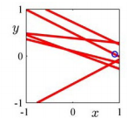
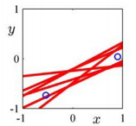
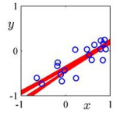


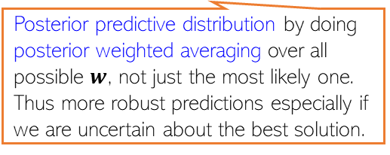
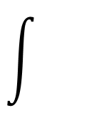
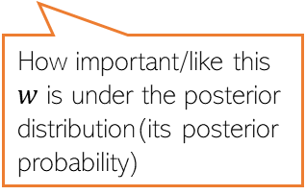


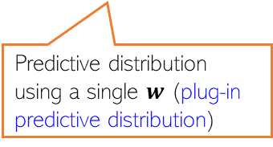
Distribution over model parameters??
Recall that linear/ridge regression gave a single “optimal” weight vector
With a probabilistic model for linear regression, we have two options
Use MLE/MAP to get a single “optimal” weight vector
Use fully Bayesian inference to learn a distribution over weight vectors (figure below)
Rather than returning just a single “best” solution (a line in this example), the fully Bayesian approach would give us several “probable” lines (consistent with training data) by learning the full posterior distribution over the model parameters (each of which corresponds to a line)
One training ex
Two training ex
A few more training ex
$$p\left(y_{∗}\right|X,y)=$$
$$p\left(y_{∗} | w,x\right)$$
$$p\left(w | X,y\right)$$
$$dw$$
In this course, we will mostly focus on probabilistic ML when using MLE/MAP and predictive distributions computed using a single best estimate (MLE/MAP). We will only briefly look some simple examples with fully Bayesian approach (CS772/775 covers this approach in greater depth)
Posterior predictive distribution by doing posterior weighted averaging over all possible $w$, not just the most likely one. Thus more robust predictions especially if we are uncertain about the best solution.
How important/like this $w$ is under the posterior distribution(its posterior probability)
Predictive distribution using a single $w$ (plug-in predictive distribution)

Slide 4



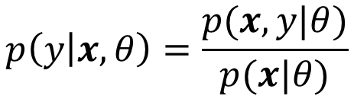
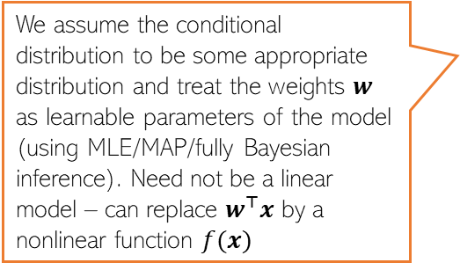

Probabilistic Models for Supervised Learning
Usually two ways to model the conditional distribution $p(y|x)$
Approach 1: Don’t model $x$, and model $p(y|x)$ directly using a prob. distribution
Approach 2: Model both $x$ and $y$ via their joint distr. and get the conditional as
“discriminative” sup learning
Gaussian distribution
We assume the conditional distribution to be some appropriate distribution and treat the weights $w$ as learnable parameters of the model (using MLE/MAP/fully Bayesian inference). Need not be a linear model – can replace $w^{⊤}x$ by a nonlinear function $f(x)$
$$p\left(y | x,w\right)=𝒩(y|w^{⊤}x,β^{−1})$$
Probabilistic linear regression
The “sigmoid” function
$$p\left(y | x,w\right)=Bernoulli(y|{σ(w}^{⊤}x))$$
Probabilistic linear binary classification
Here $θ$denotes all the model parameters that we need to model the joint distribution of $x$ and $y$ (will see examples later)
“generative” sup learning
$$p\left(y | x,θ\right)=\frac{p(x,y|θ)}{p(x|θ)}$$
Prob. distribution of inputs from class $k$
Called “generative” because we are learning the generative distributions for output as well as inputs
$p\left(y=k | x,θ\right)=\frac{p(x,y=k|θ)}{p(x|θ)}$ $=\frac{p\left(x | y=k,θ\right)p(y=k|θ)}{\sum_{ℓ=1}^{K}{p\left(x | y=ℓ,θ\right)p(y=ℓ|θ)}}$
For a multi-class classification model with $K$ classes

Slide 5
Brief Detour (Gaussian Distribution)

Slide 6
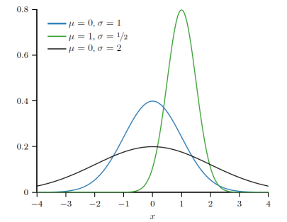
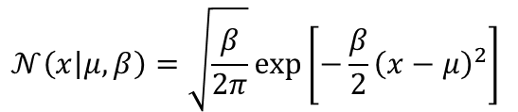
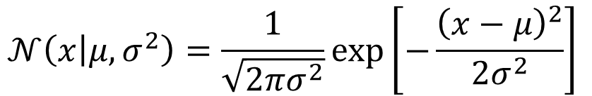

Gaussian Distribution (Univariate)
Distribution over real-valued scalar random variables $x∈ℝ$
Defined by a scalar mean $μ$and a scalar variance $σ^{2}$
Mean: $𝔼\left[x\right]=μ$
Variance: var[$x$] $=σ^{2}$
Inverse of variance is called precision: $β=\frac{1}{σ^{2}}$.
$$𝒩\left(x | μ,σ^{2}\right)=\frac{1}{\sqrt{2πσ^{2}}}exp\left[−\frac{{\left(x−μ\right)}^{2}}{2σ^{2}}\right]$$
Gaussian PDF in terms of precision
$$𝒩\left(x | μ,β\right)=\sqrt{\frac{β}{2π}}exp\left[−\frac{β}{2}{\left(x−μ\right)}^{2}\right]$$

Slide 7
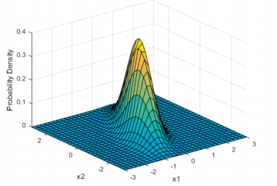
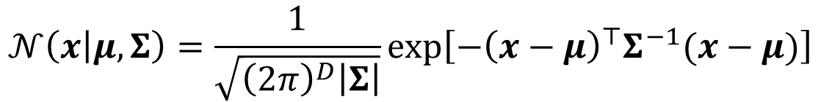

Gaussian Distribution (Multivariate)
Distribution over real-valued vector random variables $x∈ℝ^{D}$
Defined by a mean vector $μ∈ℝ^{D}$and a covariance matrix $Σ$
Note: The cov. matrix $Σ$ must be symmetric and PSD
All eigenvalues are positive
$z^{⊤}Σz≥0$ for any real vector $z$
The covariance matrix also controls the shape of the Gaussian
A two-dimensional Gaussian
$$𝒩\left(x | μ,Σ\right)=\frac{1}{\sqrt{{\left(2π\right)}^{D}\left|Σ\right|}}exp\left[−{\left(x−μ\right)}^{⊤}Σ^{−1}(x−μ)\right]$$

Slide 8
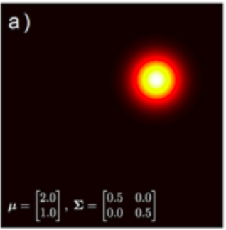
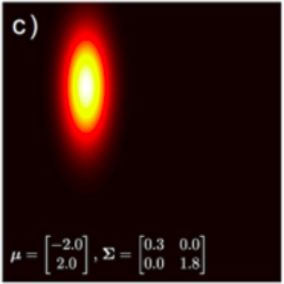
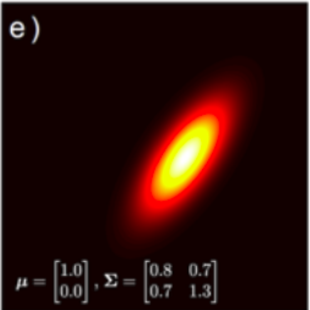
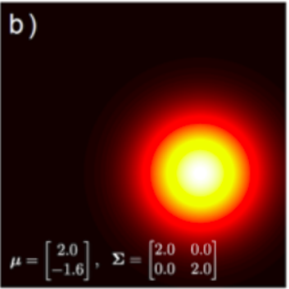
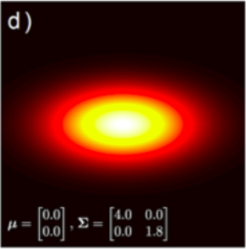
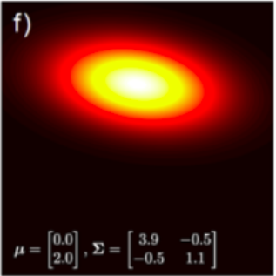
Covariance Matrix for Multivariate Gaussian
Spherical Covariance
Diagonal Covariance
Full Covariance
5
5
5
Spherical: Equal spreads (variances) along all dimensions
Diagonal: Unequal spreads (variances) along all directions but still axis-parallel
-5
5
-5
5
-5
5
5
5
5
Full: Unequal spreads (variances) along all directions and also spreads along oblique directions
-5
5
-5
5
-5
5

Slide 9
Probabilistic Linear Regression
$$p\left(y | x,w\right)=𝒩(y|w^{⊤}x,β^{−1})$$
Gaussian distribution
Other distributions can also be used for probabilistic linear regression (e.g., Laplace) as we will see later

Slide 10
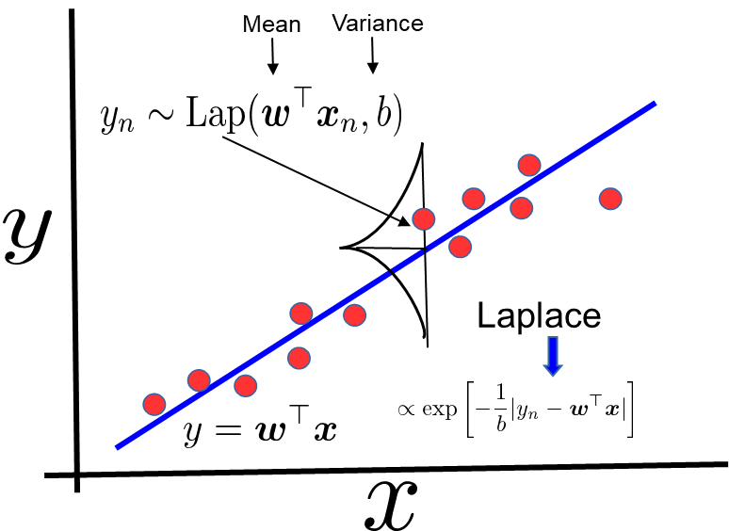
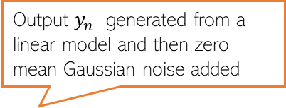
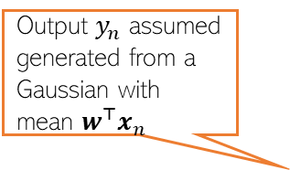
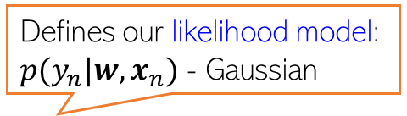


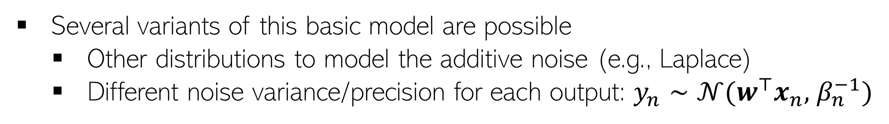
Linear Regression: A Probabilistic View
Defines our likelihood model: $p(y_{n}|w,x_{n})$ - Gaussian
Output $y_{n}$ generated from a linear model and then zero mean Gaussian noise added
Output $y_{n}$ assumed generated from a Gaussian with mean $w^{⊤}x_{n}$
Mean
Variance
Equivalently:
$$y_{n}= w^{⊤}x_{n}+ε_{n}$$
Note the term in the Gaussian’s exponent – just like a squared error we saw for least squares regression ☺
$ε_{n}∼𝒩(0,$ $β^{−1})$
Using a Laplace distribution would correspond to using an absolute loss
Gaussian
Several variants of this basic model are possible
Other distributions to model the additive noise (e.g., Laplace)
Different noise variance/precision for each output: $y_{n}∼𝒩(w^{⊤}x_{n},$ $β_{n}^{−1})$
Heteroskedastic noise

Slide 11
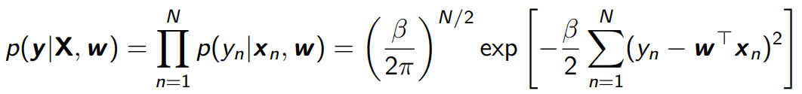
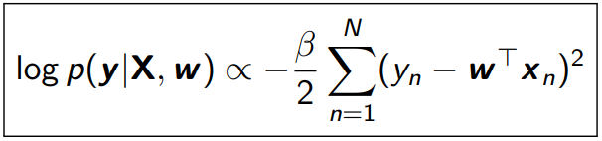


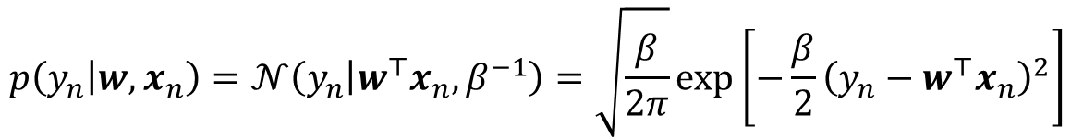

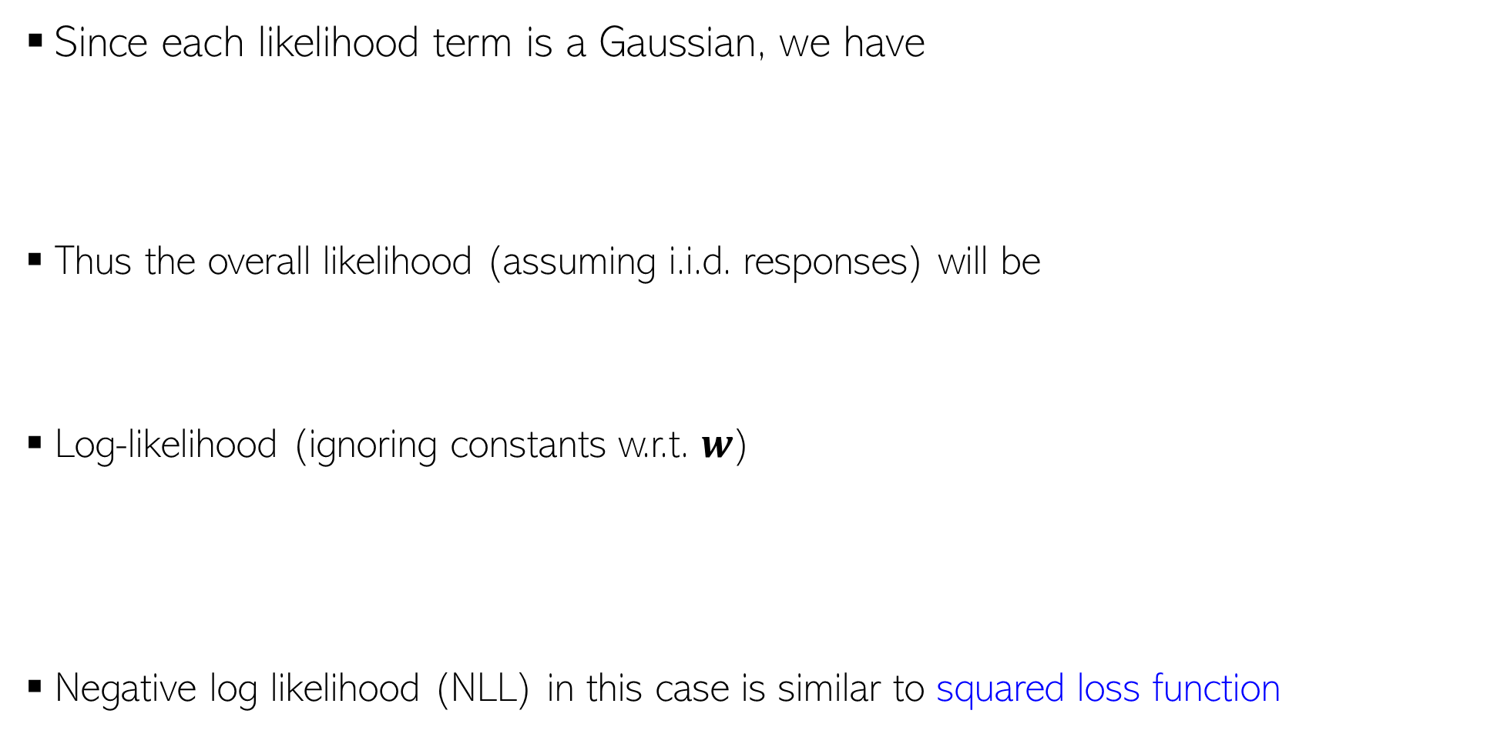
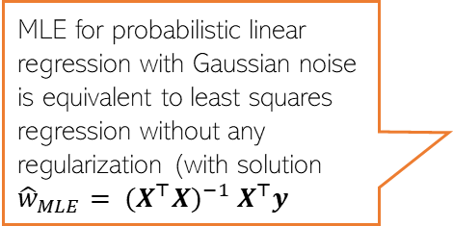
MLE for Probabilistic Linear Regression
Since each likelihood term is a Gaussian, we have
Thus the overall likelihood (assuming i.i.d. responses) will be
Log-likelihood (ignoring constants w.r.t. $w$)
Negative log likelihood (NLL) in this case is similar to squared loss function
Also note that $x_{n}$ is fixed here but the likelihood depend on it, so it is being conditioned on
$$p\left(y_{n} | w,x_{n}\right)=𝒩\left(y_{n} | w^{⊤}x_{n},β^{−1}\right)=\sqrt{\frac{β}{2π}}exp\left[−\frac{β}{2}{\left(y_{n}−w^{⊤}x_{n}\right)}^{2}\right]$$
Omitting $β$from the conditioning side for brevity
Exercise: Verify that you can also write the overall likelihood as a single $N$ dimensional Gaussian with mean $Xw$ and cov. matrix $β^{−1}I_{N}$
MLE for probabilistic linear regression with Gaussian noise is equivalent to least squares regression without any regularization (with solution ${\hat{w}}_{MLE}= {(X^{⊤}X)}^{−1}$ $X^{⊤}y$

Slide 12
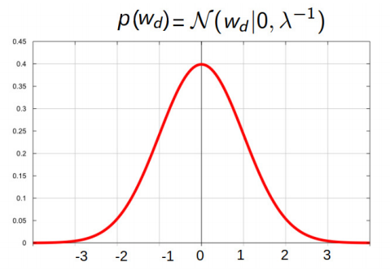


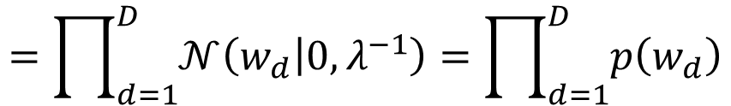

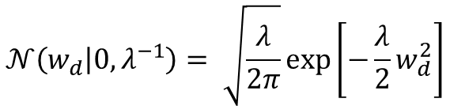


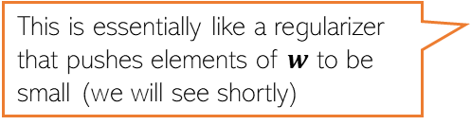

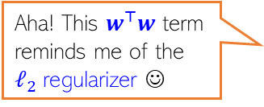
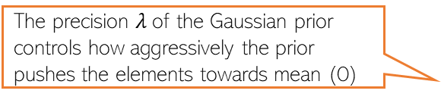
MAP Estimation for Prob. Lin. Reg.: The Prior
For MAP estimation, we need a prior distribution over the parameters $w∈ℝ^{D}$
A reasonable prior for real-valued vectors can be a multivariate Gaussian
A specific example of a multivariate Gaussian prior in this problem
Equivalent to saying that a priori we expect the solution to be close to some vector $w_{0}$
(subject to $Σ$being such that the variances is not too large
$$p\left(w\right)=𝒩\left(w | w_{0},Σ \right)$$
$$=\prod_{d=1}^{D}{𝒩\left(w_{d} | 0,λ^{−1}\right)}=\prod_{d=1}^{D}{p\left(w_{d}\right)}$$
$$p\left(w\right)=𝒩\left(w | 0,λ^{−1}I_{D} \right)$$
Omitting $λ$for brevity
The precision $λ$of the Gaussian prior controls how aggressively the prior pushes the elements towards mean (0)
Equivalent to saying that a priori we expect each element of the solution to be close to 0 (i.e., “small”)
This is essentially like a regularizer that pushes elements of $w$ to be small (we will see shortly)
$$𝒩\left(w_{d} | 0,λ^{−1}\right)= \sqrt{\frac{λ}{2π}}exp\left[−\frac{λ}{2}w_{d}^{2}\right]$$
Aha! This $w^{⊤}w$ term reminds me of the $ℓ_{2}$regularizer ☺
That’s indeed the case ☺
$$𝒩\left(w | 0,λ^{−1}I_{D} \right)={\left(\frac{λ}{2π}\right)}^{D/2}exp\left[−\frac{λ}{2}\sum_{d=1}^{D}{w_{d}^{2}}\right]={\left(\frac{λ}{2π}\right)}^{D/2}exp\left[−\frac{λ}{2}w^{⊤}w\right]$$

Slide 13
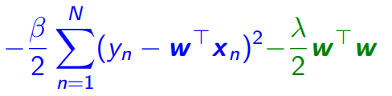
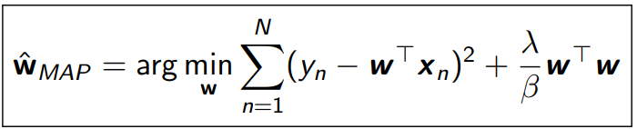
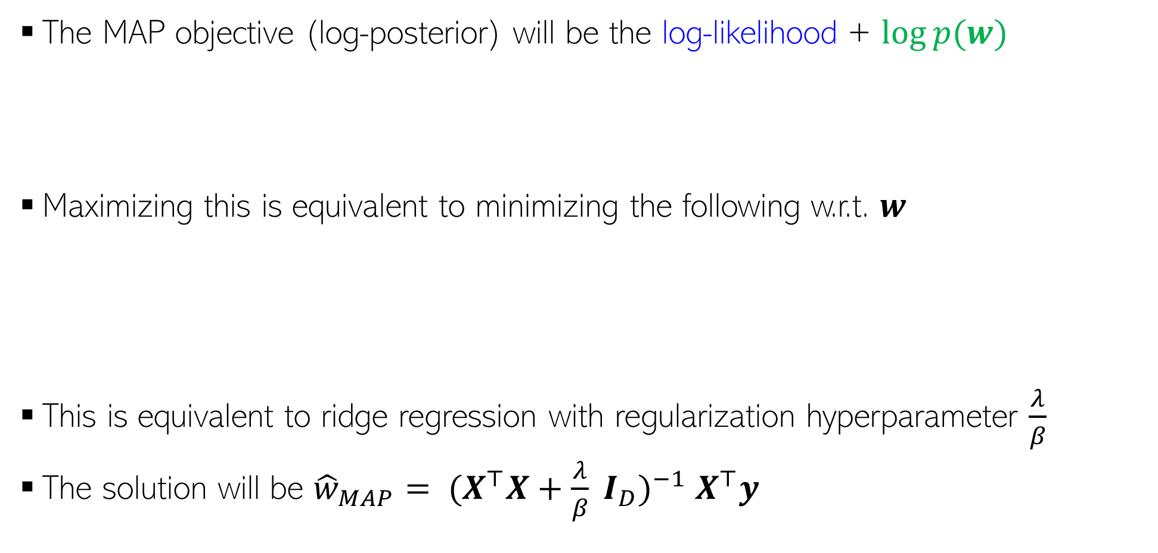
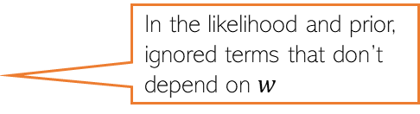
MAP Estimation for Probabilistic Linear Regression
The MAP objective (log-posterior) will be the log-likelihood + $log⁡p(w)$
Maximizing this is equivalent to minimizing the following w.r.t. $w$
This is equivalent to ridge regression with regularization hyperparameter $\frac{λ}{β}$
The solution will be ${\hat{w}}_{MAP}= {(X^{⊤}X+\frac{λ}{β} I_{D})}^{−1}$ $X^{⊤}y$
In the likelihood and prior, ignored terms that don’t depend on $w$
Not surprising since MAP estimation indeed optimizes a regularized loss function! ☺

Slide 14

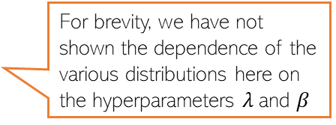



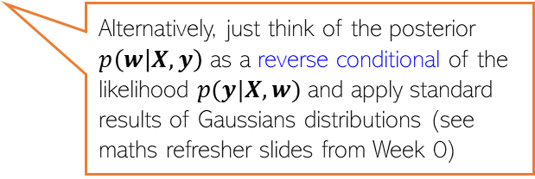


Fully Bayesian Inference for Prob. Linear Regression
Can also compute the full posterior distribution over $w$
Likelihood and prior are conjugate (both Gaussians) - posterior will be Gaussian
$$p\left(w | X,y\right)= \frac{p\left(w\right)p(y|X,w)}{p(y|X)}$$
For brevity, we have not shown the dependence of the various distributions here on the hyperparameters $λ$and $β$
Posterior’s mean is the same as the MAP solution since the mean and mode of a Gaussian are the same!
Deriving this result requires a bit of algebra (not too hard though).
$$p\left(w | X,y\right)= 𝒩(μ_{N}, Σ_{N})$$
$μ_{N}={(X^{⊤}X+\frac{λ}{β} I_{D})}^{−1}$ $X^{⊤}y$
Note: $λ$and $β$are assumed to be fixed; otherwise, the problem is a bit harder (beyond the scope of CS771)
We already know that the result will be Gaussian (due to conjugacy) – just need to multiply and rearrange terms to bring the result into a Gaussian form and identify the mean and covariance of that Gaussian – can be done using the “completing the squares” trick. Don’t even need to worry about calculating the marginal. Will provide a note
$$Σ_{N}={({βX}^{⊤}X+λI_{D})}^{−1}$$
We now have a distribution over the possible solutions – it has a mean but we can generate other plausible solutions by sampling from this posterior. Each sample will give a weight vector
Alternatively, just think of the posterior $p\left(w | X,y\right)$ as a reverse conditional of the likelihood $p(y|X,w)$and apply standard results of Gaussians distributions (see maths refresher slides from Week 0)

Slide 15





Prob. Linear Regression: The Predictive Distribution
Want the predictive distribution $p(y_{∗}|x_{∗}, X, y)$of the output $y_{∗}$ for a new input $x_{∗}$(
With MLE/MAP estimate of $w$, we will use the plug-in predictive
When doing fully Bayesian inference, can compute the posterior predictive dist.
Requires an integral but has a closed form
Input-specific predictive uncertainty useful in problems where we want confidence estimates of the predictions made by the model (e.g., Active Learning)
Not true in general for Prob. Lin. Reg. but because the hyperparameters $λ$and $β$ are treated as fixed
Mean prediction
Input-specific predictive variance unlike the MLE/MAP based predictive where it was $β^{−1}$ (and was same for all test inputs)

Slide 16



Fully Bayesian Linear Regression – Pictorially
Each sample from posterior $p\left(w | X,y\right)= 𝒩\left(μ_{N}, Σ_{N}\right)$ will give a weight vector $w$
In case of lin. reg., each weight vector corresponds to a regression line
Each weight vector will give a different set of predictions on test data
These different predictions will give us a variance (uncertainty) estimate in model’s prediction
The uncertainty decreases as $N$ increases (we become more sure when we see more training data)
The variance of both posterior and post. pred. reduces as $N$ grows (
The posterior sort of represents an ensemble of solutions (not all are equally good but we can use all of them in an “importance-weighted” fashion to make the prediction using the posterior predictive distribution)
Importance of each solution in this ensemble is its posterior probability $p\left(w | X,y\right)$
Pic source: https://waterprogramming.wordpress.com/

Slide 17


MLE, MAP/Fully Bayesian Lin. Reg: Summary
MLE/MAP give point estimate of $w$
MLE/MAP based prediction uses that single point estimate of $w$
Fully Bayesian approach gives the full posterior of $w$
Fully Bayesian prediction does posterior averaging (computes posterior predictive distribution)
Some things to keep in mind:
MLE estimation of a parameter leads to unregularized solutions
MAP estimation of a parameter leads to regularized solutions
A Gaussian likelihood model corresponds to using squared loss
A Gaussian prior on parameters acts as an $ℓ_{2}$ regularizer
Other likelihoods/priors can be chosen (result in other loss functions and regularizers)
Can extend Bayesian linear regression to handle nonlinear regression
Using kernel based feature mapping $φ(x)$: Gaussian Process regression
E.g., using Laplace distribution for likelihood is equivalent to absolute loss, using it as a prior is equivalent to $ℓ_{1}$regularization

Slide 18






Evaluation Measures for Regression Models
Plotting the prediction ${\hat{y}}_{n}$ vs truth $y_{n}$ for the validation/test set
Residual Sum of Squares (RSS) on the validation/test set
RMSE (Root Mean Squared Error) $≜\sqrt{\frac{1}{N}RSS(w)}$
Coefficient of determination or $R^{2}$
Plots of true vs predicted outputs
and $R^{2}$ for two regression models
$$RSS\left(w\right)=\sum_{n=1}^{N}{{\left(y_{n}\text{ − }{\hat{y}}_{n}\right)}^{2}}$$
$$R^{2}=1− \frac{\sum_{n=1}^{N}{{\left(y_{n}\text{ − }{\hat{y}}_{n}\right)}^{2}}}{\sum_{n=1}^{N}{{\left(y_{n}\text{ −} \overline{y}\right)}^{2}}}$$
“relative” error w.r.t. a model that makes a constant prediction $\overline{y}$for all inputs
Unlike RSS and RMSE, it is always between 0 and 1 and hence interpretable
$\overline{y}$ is empirical mean of true responses, i.e., $\frac{1}{N}\sum_{n=1}^{N}{y_{n}}$
Pic from MLAPP (Murphy)

Slide 19
Coming up next
Probabilistic modeling classification problems
Logistic regression and softmax regression

